Slide 1
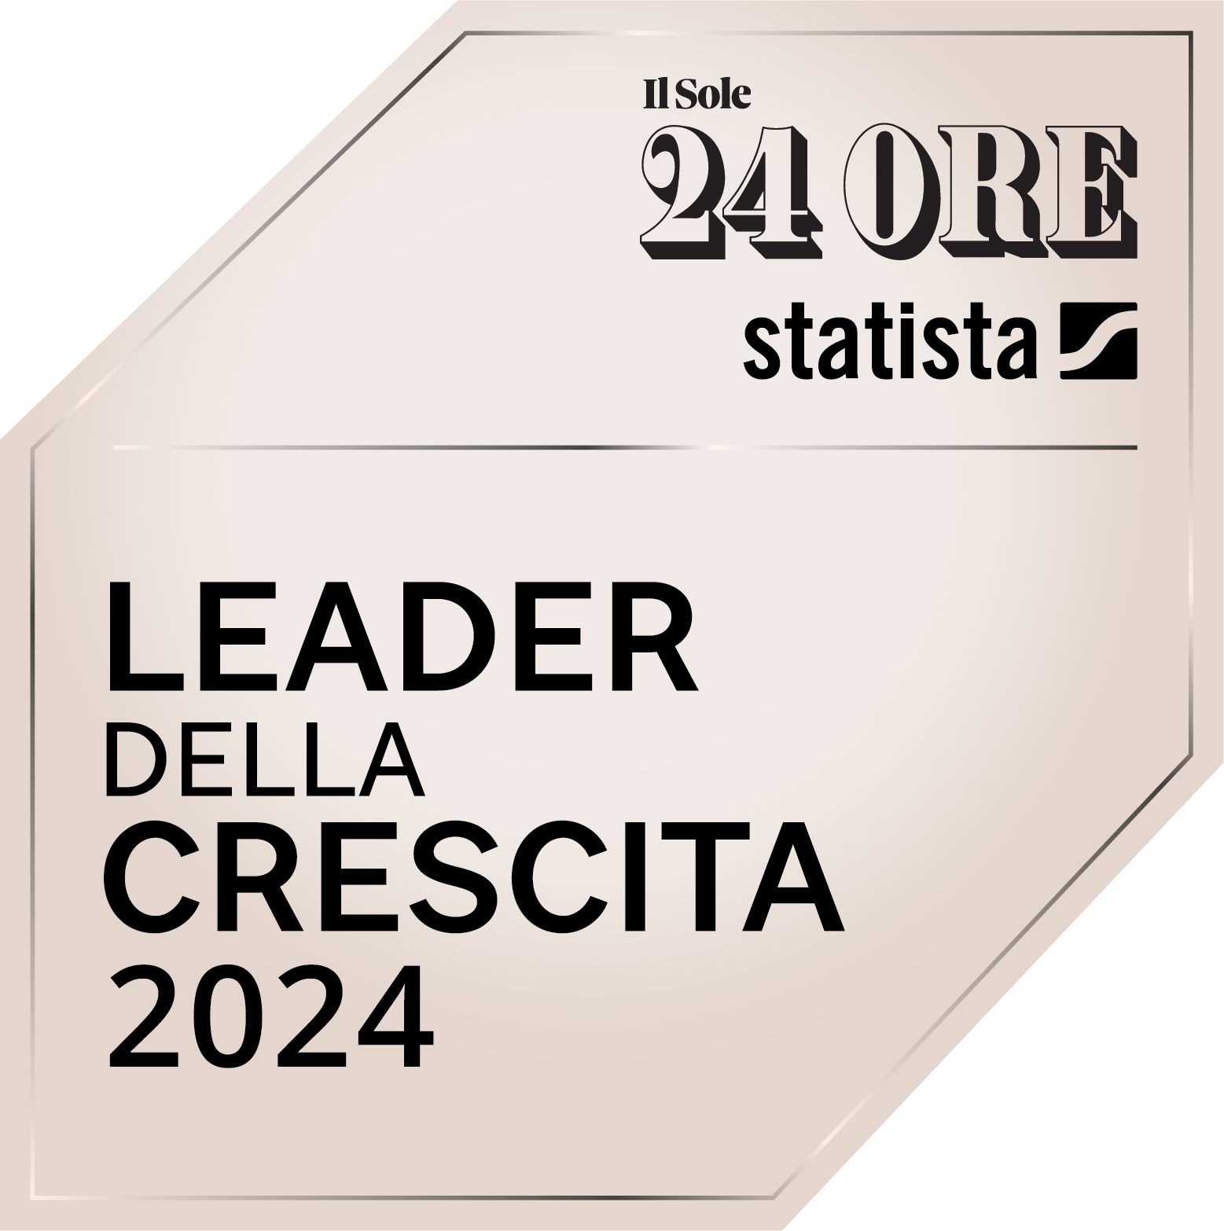





Business Central
>AI Hackathon

Slide 2

Business Central | AI Hackathon
Our Idea
Our solution enables Business Central users to interact with the system via voice messages on platforms like WhatsApp or Teams, allowing them to receive information or initiate tasks such as draft quotes without direct access to their PC or app.

Slide 3
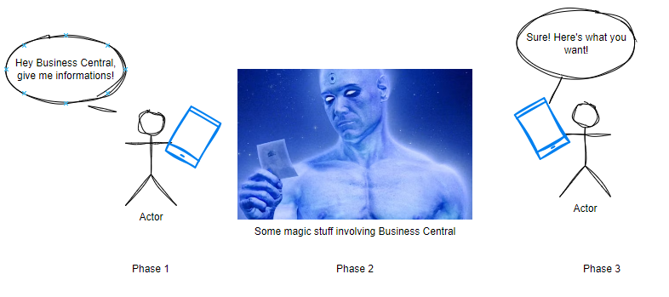
Business Central | AI Hackathon
What our imaginary user wants

Slide 4
Business Central | AI Hackathon
The use case
An authorized Salesperson wants to use a voice message to:
- Insert a sales quote and get back the PDF
- Ask an item price for a specific customer
- Get a customer status (overdue payments, blocked status, etc…)
- …
(in this demo we focused on the first case)

Slide 5
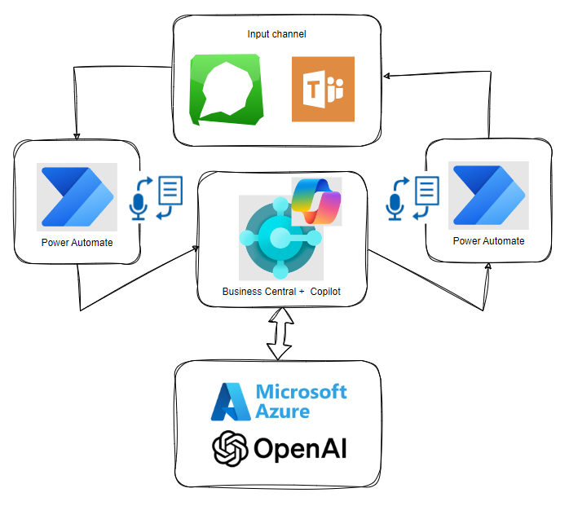
Business Central | AI Hackathon
The Design
The solution can accommodate various input and feedback channels. We decided to achieve this result using WhatsApp, to make the test more challenging.

Slide 6
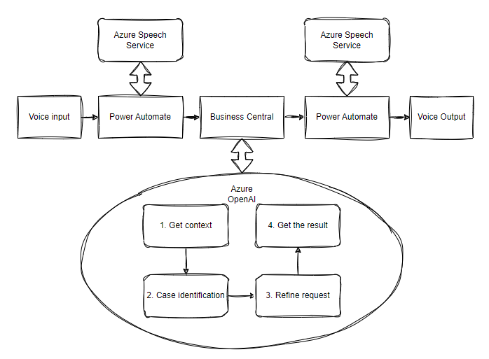
Business Central | AI Hackathon
The Flow

Slide 7
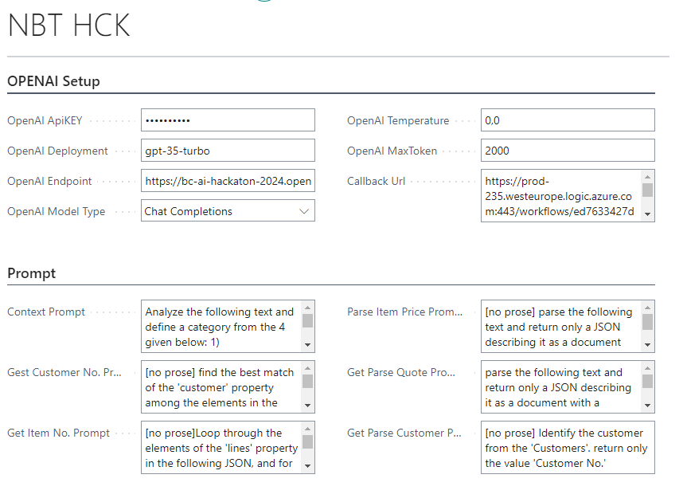
Business Central | AI Hackathon
Screenshots
Application Setup:
- OpenAI Key and parameters
- Chat Prompts for various scenarios

Slide 8
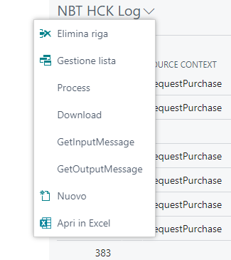
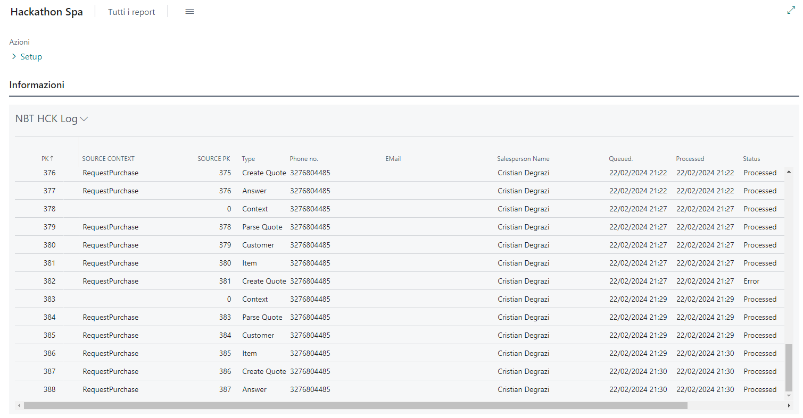
Business Central | AI Hackathon
Screenshots
Application Log
In the application Log is possible to control the flow, get input and output messages and manually process every single step for testing and debug purposes.

Slide 9
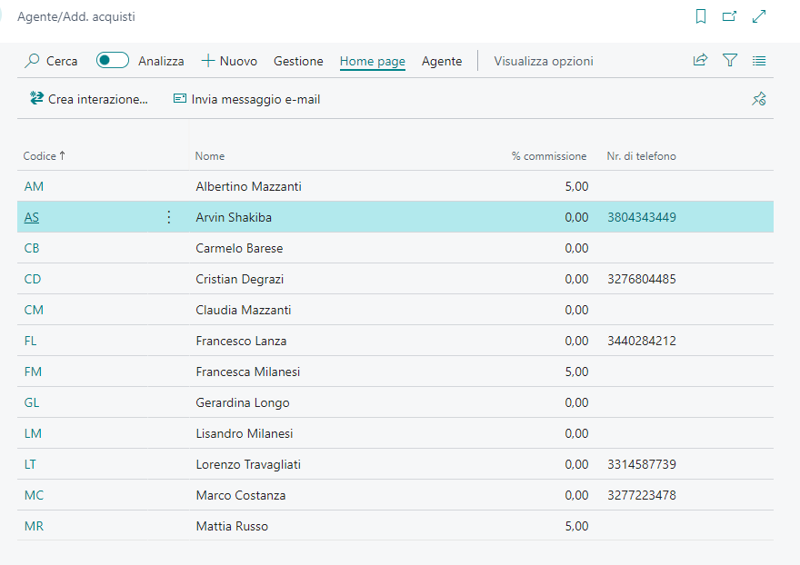
Business Central | AI Hackathon
Screenshots
Authorizations
In this demo, only registered SalesPersons with a mobile number in Business Central can send messages to the system.

Slide 10
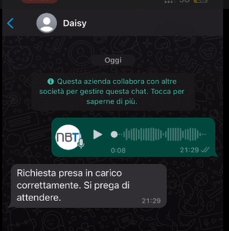
Business Central | AI Hackathon
Field Test
Arvin Shakiba sends a message via WhatsApp and receives an initial confirmation of successful receipt (via WhatsApp API)
(we called our bot Daisy)

Slide 11
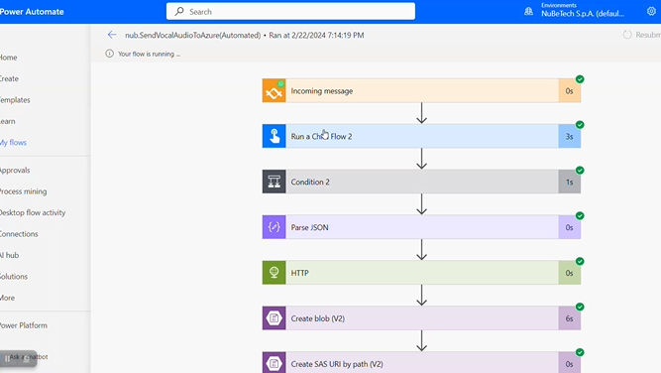
Business Central | AI Hackathon
Field Test
The first Power Automate Flow gets the message, interacts with Azure Speech services, converts the audio in a txt and sends it to Business Central via API

Slide 12
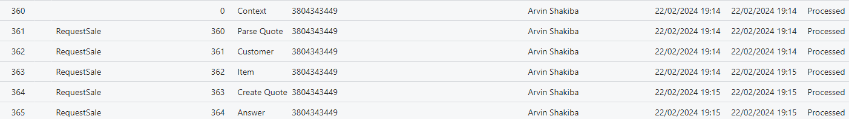
Business Central | AI Hackathon
Field Test
Business Central gets the message and begins its magic

Slide 13
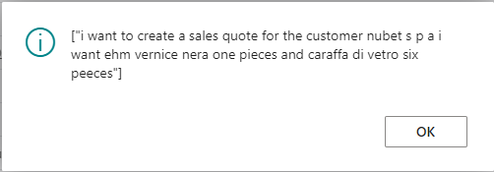
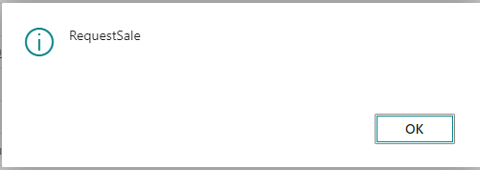
Business Central | AI Hackathon
Field Test
1° step: Context
Thanks to Azure OpenAI and the right prompts, we know that we are in «RequestSale» case

Slide 14
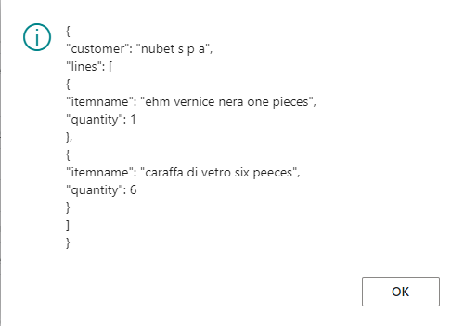
Business Central | AI Hackathon
Field Test
2° step: ParseQuote
Azure OpenAI gives us a first JSON

Slide 15
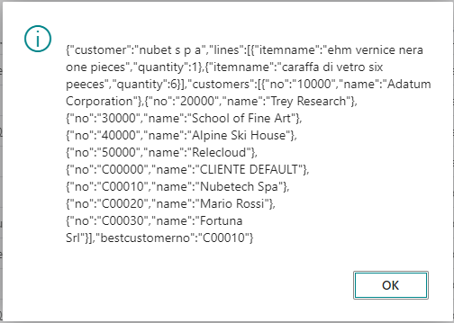
Business Central | AI Hackathon
Field Test
3° step: Customer
Azure OpenAI compares the requested customer with the corresponding table and adds a 'bestCustomerNo’ element to the JSON

Slide 16
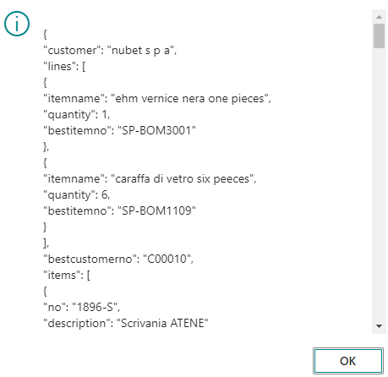
Business Central | AI Hackathon
Field Test
4° step: Item
Azure OpenAI does the same thing with the items, adding a «bestItemNo» to every recognized element.

Slide 17
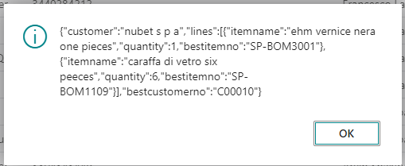
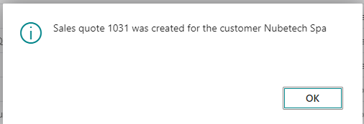
Business Central | AI Hackathon
Field Test
5° step: Create Quote
Azure OpenAI compose a new clean JSON and create the Sales quote.

Slide 18
Business Central | AI Hackathon
Field Test
6° step: Answer
Business Central contatcs the Power Automate endpoint ands sends back the sales quote confirmation and the PDF

Slide 19
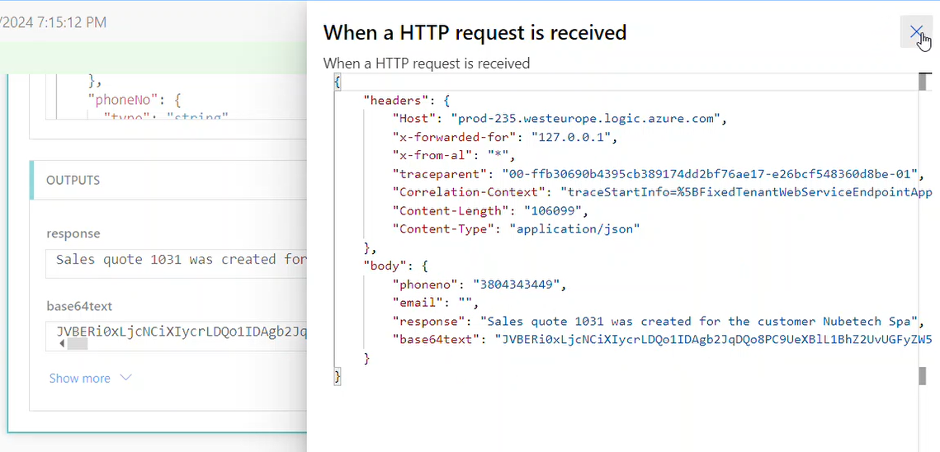
Business Central | AI Hackathon
Field Test
PowerAutomate gets the data, uses Azure Speech Service to convert the text to an audio file, gets the PDF and saves both files in an Azure blob Storage…

Slide 20
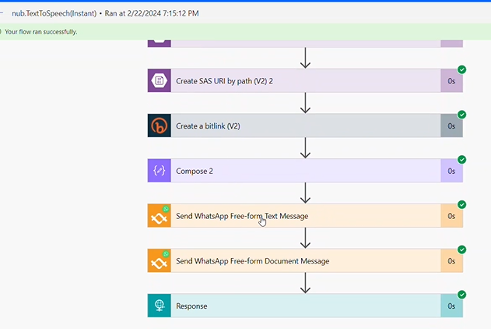
Business Central | AI Hackathon
Field Test
…sends it back to the original sender…

Slide 21
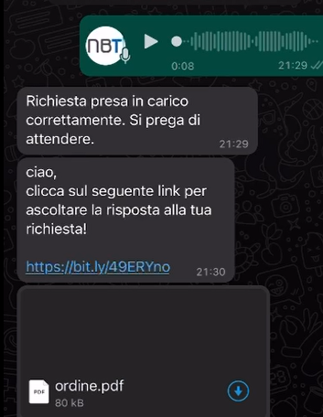
Business Central | AI Hackathon
Field Test
…and now our Sales guy gets and audio message with the confirmation and the number of the sales quote, and the PDF too!

Slide 22
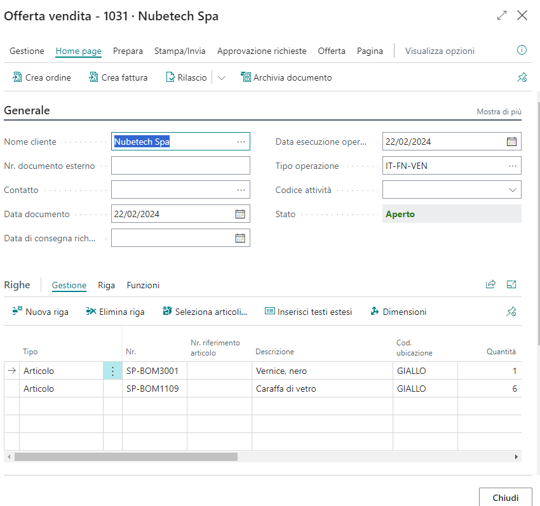
Business Central | AI Hackathon
Field Test
When back to the PC, the Sales Quote is there!

Slide 23
Business Central | AI Hackathon
Error Management
This is a very rough first draft, but for now, we have identified the following cases:
- If the system cannot find a “bestCustomerNo”, the quote is assigned to a generic customer.
- If the system cannot find one or more “bestItemNo”, the quote lines will be of comment type, with a description and the requested quantity

Slide 24
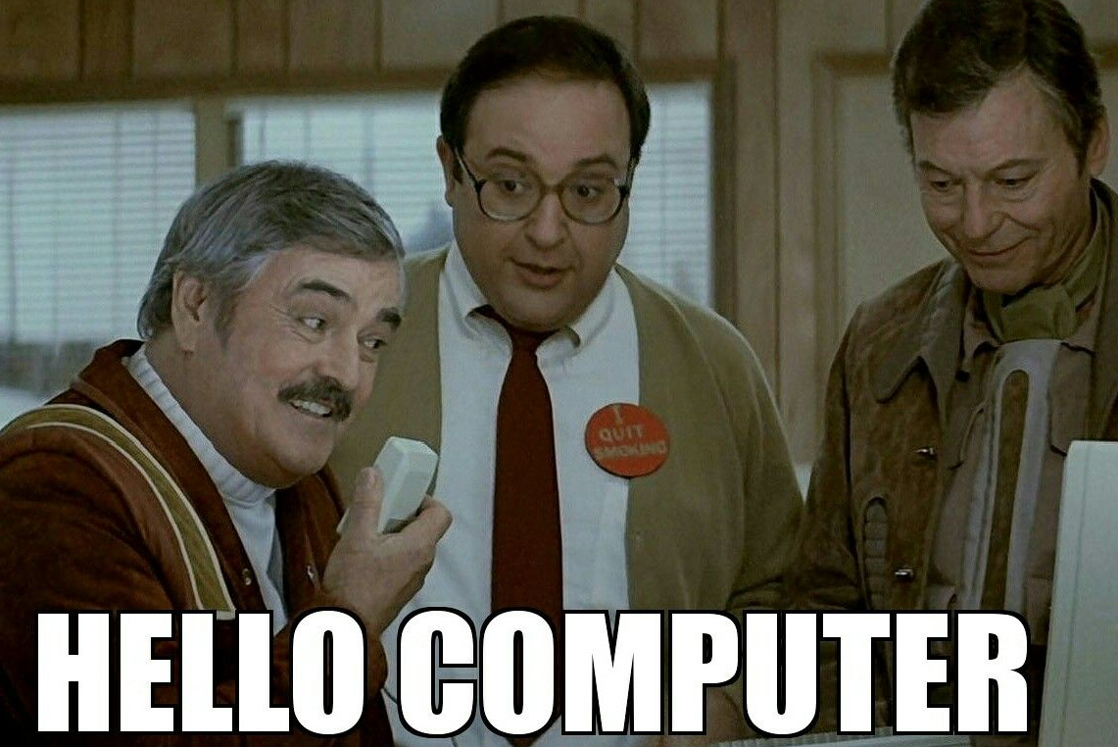
Business Central | AI Hackathon
The Future

Slide 25
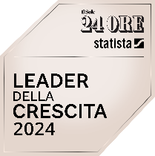
Via Milano, 37/C
20064 - Gorgonzola (MI)
Via Strada Scaglia Est, 33
41126 - Modena (MO)
Via Nona Strada 23
35129 - Padova (PD)
P.zza Borgo Pila, 40/7
16129 - Genova (GE)
Our Team:
Arvin Shakiba - Nubetech
Lorenzo Travagliati - Nubetech
Marco Costanza – 9Ways
Alberto Valenti – 9Ways
Francesco Lanza - Nubetech
Special thanks to
Dmitry Katson (He is The Man)
Cristian Degrazi (He taught us
everything we know about
Power Automate)
info@nubetech.it
02/48731516
www.nubetech.it
www.nubetechgroup.com

